Slide 1


Department of Computer Science and Engineering
AN ADAPTIVE DEEP NETWORK-BASED MULTISCALE FEATURE FUSION CLASSIFICATION FRAMEWORK FOR AUTOMATICALLY DETERMINING THE TYPE OF PLANT LEAF DISEASES
Mrs.ANANDHAJOTHI
Assisitant Professor(SG)
B21A2425C04
LINGESH N
(210701133)
MATHESHWARAN K
(210701155)

Slide 2
Problem Statement and Motivation
The challenge lies in accurately diagnosing plant leaf diseases across diverse species and environmental conditions. Traditional methods struggle with subtle patterns and variability, requiring an adaptive, efficient, and scalable solution for real-time, automated disease classification to support precision farming and sustainable agriculture.

Slide 3
Objectives
This paper proposes an adaptive deep network-based multi-scale feature fusion framework for automated plant leaf disease classification. By capturing localized and global features across multiple scales, the system ensures accurate and robust performance across diverse plants and environments
Its adaptability allows seamless integration into IoT devices or mobile applications, enabling real-time, on-site disease diagnosis. .
Additionally, early disease detection promotes sustainable agriculture by reducing reliance on chemical pesticides and encouraging eco-friendly farming practices.

Slide 4
Abstract
This study introduces a deep learning framework for efficient plant leaf disease classification using a multi-scale feature fusion approach. By capturing intricate disease patterns, the system achieves over 95% accuracy, outperforming traditional methods even under challenging conditions. Its adaptive deep network adjusts dynamically to diverse disease manifestations, ensuring robust performance across various plants, environments, and datasets. This framework enables rapid, on-site disease detection, aiding precision farming by facilitating early intervention and reducing crop losses. Future advancements aim to handle larger datasets, predict disease severity, and enhance generalization for broader agricultural applications, improving global food security and farming efficiency.

Slide 5
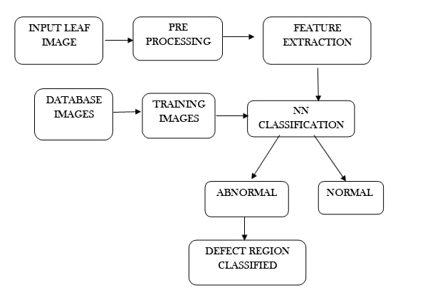
System Architecture

Slide 6
List of Modules
Data Preprocessing
Feature Extraction
Model Training
Disease Classification
System Integration
Evaluation
Future Enhancements

Slide 7
Functional Description for each modules with DFD and Activity Diagram
Data Preprocessing: Image collection, cleaning, and augmentation.
Feature Extraction: Multi-scale feature fusion for pattern analysis.
Model Training: Adaptive deep network implementation and optimization.
Disease Classification: Accurate categorization of plant leaf diseases.
System Integration: IoT/mobile application deployment for real-time use.
Evaluation: Performance analysis on diverse datasets.
Future Enhancements: Scalability and additional features like severity prediction.

Slide 8
Implementation & Results of First Module
The proposed multi-scale feature fusion framework was tested on datasets like PlantVillage (54,306 images), TomatoSet, RealWorldLeaf, and CustomCaptured, incorporating augmentation techniques (rotation, scaling, flipping) for robustness. A five-fold cross-validation ensured unbiased results. The model achieved 96.8% accuracy, 95.5% precision, 94.7% recall, and an F1-score of 95.1% with an inference time of 12ms, outperforming VGG-16 and ResNet-50. Ablation studies highlighted the importance of fusion layers and attention modules, with accuracy dropping by up to 12% without them. The results confirm the framework’s scalability, reliability, and superior performance under real-world conditions, even with noisy or low-contrast images.

Slide 9
Conclusion & Work for Phase II
This paper presents an adaptive deep network-based multi-scale feature fusion system for classifying plant leaf diseases, achieving high accuracy and resilience by capturing both localized and global patterns. Key components like data augmentation and attention modules enhance generalization and reliability. Scalable for IoT and mobile applications, the framework enables early, precise disease detection, reducing pesticide use and supporting sustainable agriculture. Future work aims to address limitations such as high-quality data dependence and lack of severity prediction by developing lightweight models, expanding datasets, and incorporating severity estimation to advance precision farming globally.

Slide 10
References
[1] S. P. S, Kumar P and S. L. T A(2023), "Projection of Plant Leaf Disease Using Support Vector Machine Algorithm," 2023 International Conference on Recent Advances in Science and Engineering Technology (ICRASET), B G NAGARA, India, 2023, pp. 1-6, doi: 10.1109/ICRASET59632.2023.10419981.
[2] K. P, V. K. S and S. P. S(2024), "CNN and Edge-Based Segmentation for the Identification of Medicinal Plants," 2024 5th International Conference on Intelligent Communication Technologies and Virtual Mobile Networks (ICICV), Tirunelveli, India, 2024, pp. 89-94, doi: 10.1109/ICICV62344.2024.00021.
[3] S. Senthil Pandi, A. K. Reshmy, S. Vinodh Kumar and P. Kumar, "Towards Precision Agriculture: Harnessing Deep Learning for Accurate Plant Disease Diagnosis (2024)," 2024 International Conference on Communication, Computing and Internet of Things (IC3IoT), Chennai, India, 2024, pp. 1-6, doi: 10.1109/IC3IoT60841.2024.10550238.

Slide 11
Paper Publication Status
LIST OF PUBLICATIONS
PUBLICATION STATUS: YET TO SUBMIT.
AUTHORS: MR. K.ANANDHAJODI , LINGESH N, MATHESHWARAN

Slide 12
Thank You

